Slide 1

Tabletop Tablet Pilot

Slide 2
Sauce & Spoon has successfully completed the test launch of table top Tablets at the North and Downtown restaurant. We invited 50 friends and family to try out our new Tablet menu and see the working. This presentation will provide the results of this test launch.
Summary

Slide 3
The project team wanted to measure the following from the survey against our evaluation criteria.
Tablet performance
Ease of use
Customer satisfaction
Check-out process
Time taken to receive food
Accuracy of order
Overview

Slide 4
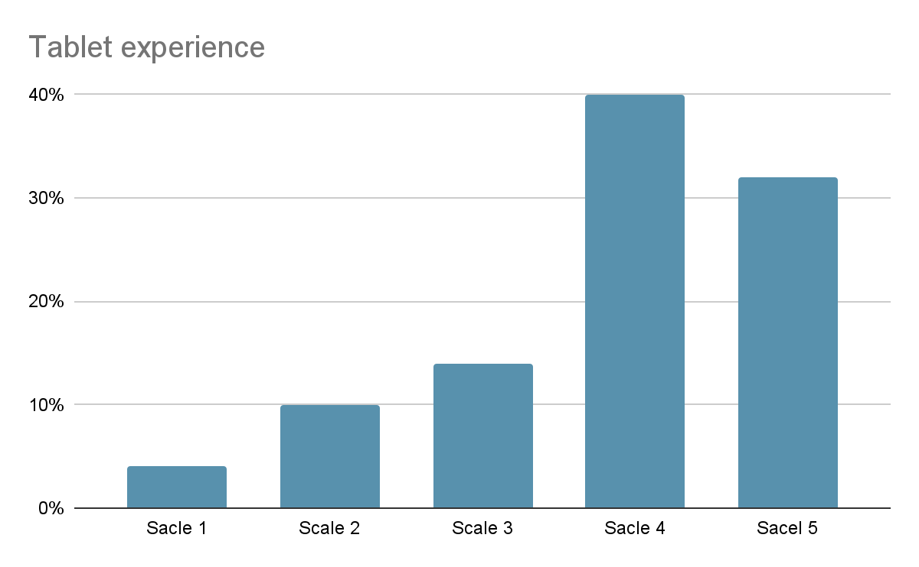
Overall experience with the tablet
More than 70% of the customers felt Great about the overall tablet experience
Around 25% of the customers were neutral with the tablet experience
Less than 5% of the customers felt that the tablet experience was lacking
Findings

Slide 5
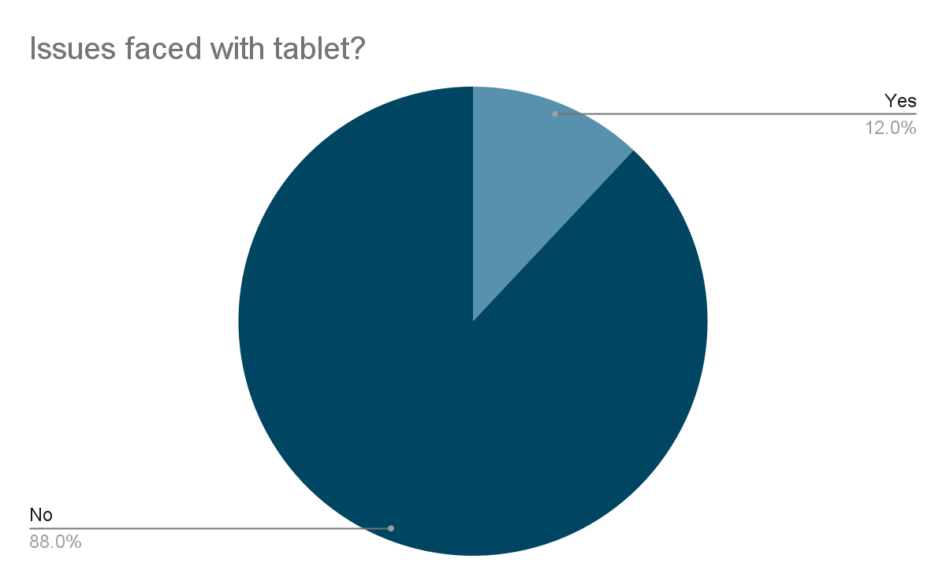
Less than 15% of customers faced Technical issues
with the tablet
Proposed next steps to fix this,
Work with vendor to check, if tablet has latest
Software to prevent screen froze
Work with service provider and ensure,
there is no bandwidth or connectivity issues
Next Steps

Slide 6
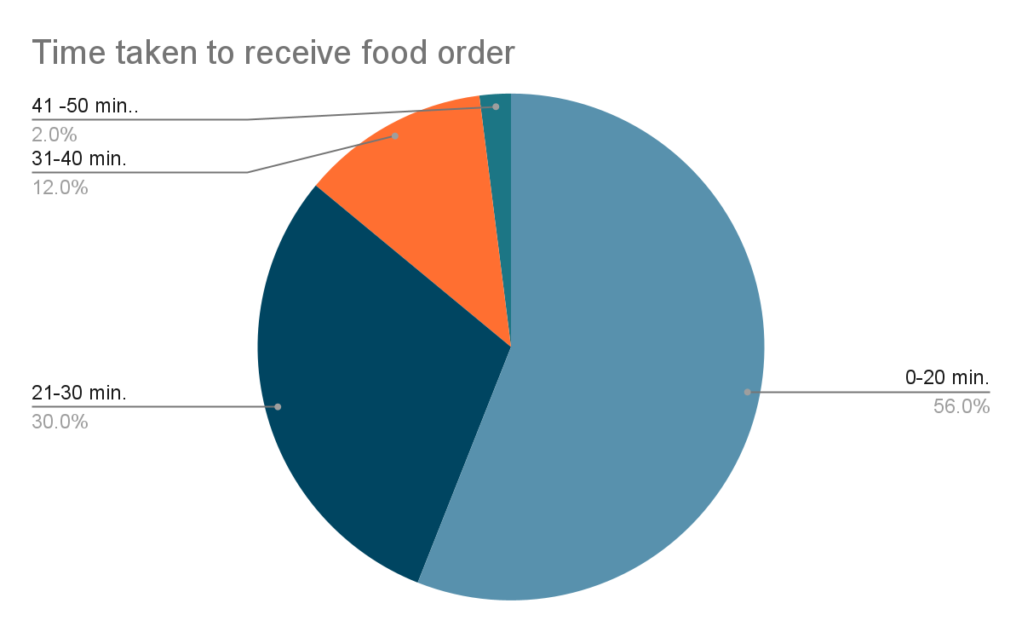
More than 40% of customers received the food
Order later than 20 minutes.
Proposed next steps,
Check with kitchen staff to see, if the orders
are received on time
Verify tablet functionality for any time lag,
when sending order to kitchen
Next Steps

